Slide 1
PID

Slide 2
PID Controller
There are many approaches to control attitude of the multicopter. From the simplest one based on standard PID controller. A proportional-integral-derivative controller (PID controller) is a control loop feedback mechanism (controller) widely used in industrial control systems.
A PID controller calculates an error value as the difference between a measured process variable and a desired setpoint. The controller attempts to minimize the error by adjusting the process through use of a manipulated variable.

Slide 3
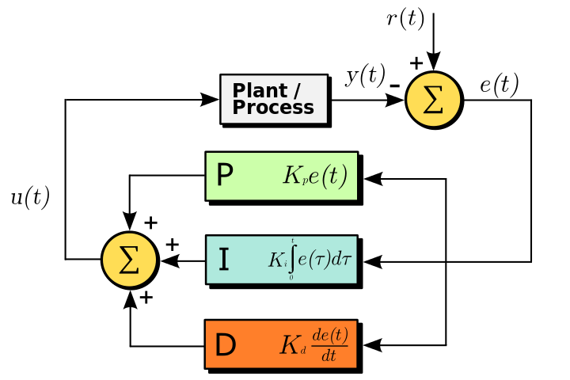
PID Controller

Slide 4
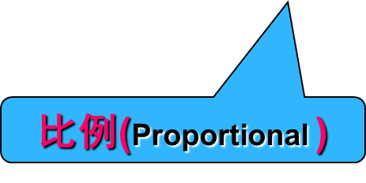
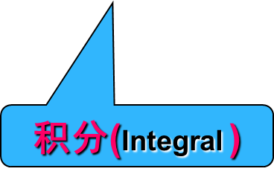
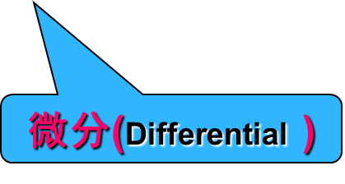
PID Controller
NOW
PAST
FUTURE

Slide 5

Proportional Controller
比例控制器的微分方程为：u = $K_{p}$e(t)
u为控制器输出
Kp为比例系数
e(t)为控制器输入偏差
由上式可以看出比例控制的特点：控制器的输出与输入偏差成正比。只要偏差出现，就能及时地产生与之成比例的调节作用，使被控量朝着减小偏差的方向变化，具有调节及时的特点。但是，Kp过大会导致动态品质变坏，甚至使系统不稳定。

Slide 6
Proportional Controller
对当前时刻的偏差信号e(t)进行放大或衰减后作为控制信号输出。
比例系数Kp越大，控制作用越强，系统的动态特性也越好，动态性能主要表现为起动快，对阶跃设定跟随得快。
但对于有惯性的系统，Kp过大时会出现较大的超调，甚至引起系统振荡，影响系统稳定性。
比例控制虽然能减小偏差，却不能消除静态偏差。
阶跃响应特性曲线

Slide 7

Integral Controller
积分作用是指控制器的输出与输入偏差的积分成比例的作用，其作用是消除静差。积分方程为： u = $\frac{1}{T_{i}}\int_{0}^{T}{e\left(t\right)dt}$ = $K_{i}\int_{0}^{T}{e\left(t\right)dt}$
Ti是积分时间常数，它表示积分速度的大小，Ti越大，积分速度越慢，积分作用越弱。积分作用的响应特性曲线，如下图所示
由图中曲线看出积分作用的特点：只要偏差不为零就会产生对应的控制量并依此影响被控量。增大Ti会减小积分作用，即减慢消除静差的过程，减小超调，提高稳定性。积分控制不能及时地克服扰动的影响。
积分作用响应曲线

Slide 8
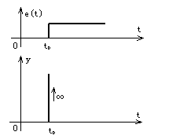

Derivative Controller
微分控制的作用是对偏差的变化进行控制，并使偏差消失在萌芽状态，其微分方程为：u = $K_{d}\frac{de(t)}{dt}$
可见，微分分量对偏差的任何变化都会产生控制作用，以调整系统输出，阻止偏差变化，预见随后。偏差变化越快，则产生的阻止作用越大。对于一个固定不变的偏差e(t)，不论其数值多大，根本不会有微分作用输出。从分析看出，微分作用的特点是：加入微分调节将有助于减小超调量，克服震荡，使系统趋于稳定。ta加快了系统的动作速度，减小调整的时间，从而改善了系统的动态性能。但不能消除静态偏差。
微分作用响应曲线

Slide 9
PID Controller
在模拟系统中，PID算法的表达式：
对上式离散化

Slide 10
PID Controller
位置式PID算法

Slide 11
Cascade PID Controller
The Reasons to use cascade：
Allow faster secondary controller to handle disturbances in the secondary loop.
Allow secondary controller to handle non-linear valve and other final control element problems.
Allow operator to directly control secondary loop during certain modes of operation (such as startup).
在系统的运行中，由于外界的干扰，使得加速度计的采集数据失真导致姿态解算出现错误。而由于陀螺仪的原理所定，一般不存在受到外界干扰的情况，因此引进角速度环组成闭环 PID 控制算法。闭环 PID 是在外环（角度环）后加入内环（角速度环） ，把外环的输出作为内环的输入，然后与陀螺仪的数据做差得到角速度误差，经过角速度 PID 控制器后得到系统输出。系统的输出又可以由姿态解算得到当前
的角度输出给外环，从而形成闭环。闭环 PID 相比于单环 PID，不仅抗干扰能力强，
并且回复迅速，增强了系统的鲁棒性。

Slide 12
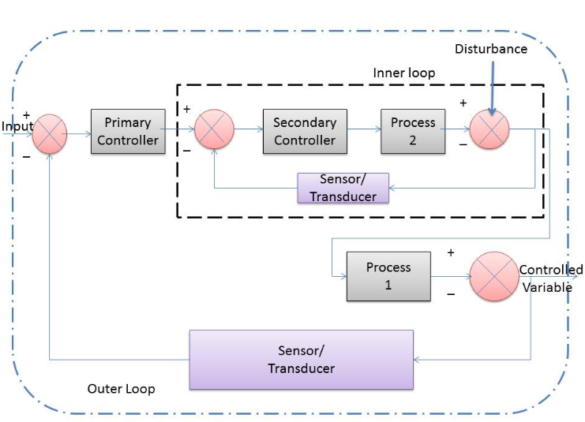
Cascade PID Controller
Cascade Control System：In a cascade control arrangement, there are two (or more) controllers of which one controller’s output drives the set point of another controller.

Slide 13
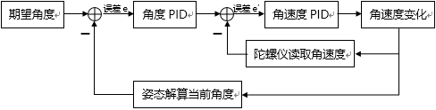
Cascade PID Controller

Slide 14
The inner loop controller
The inner loop controller is known as the slave or secondary controller.
It measures a second variable whose value affects the controlled variable.
The setpoint is supplied by the output from the outer loop.
Its output signal is used as the signal to the manipulated variable.

Slide 15
The outer loop controller
The outer loop controller is also known as the master or primary controller.
The input to this controller is the measured value of the variable to be controlled.
The setpoint is supplied by the operator.
It passes its output signal to the inner control loop.

Slide 16
Cascade PID Controller
The Requirements for cascade control：
Secondary loop must be measured and controllable.
Secondary loop must have influence over the primary loop.
Secondary loop process dynamics must be at least four times as fast as primary loop process dynamics.

Slide 17
Cascade PID Controller
The advantage of cascade control：
The major benefit from using cascade control is that disturbances arising within the secondary loop are corrected by the secondary controller before they can affect the value of the primary controlled output.
Cascade control is especially effective if the inner loop is much faster than the outer loop and if the main disturbances affect the inner loop first.
Reducing the response time.
Reducing the disturbance’s effects, as much as 1/3 – 1/10.
More accurate control for set-point, error from 10% to 1%.
Better linearity and Larger working range

Slide 18
Task4
完成串级PID控制部分

